Slide 1
Chris Cagle
Regional Affairs Manager
Robert Chavez
One Stop Supervisor

Slide 2
Workforce Boards
We help people find jobs and help businesses find workers
All services are provided at
NO COST
through One Stop Center Locations
For Business, Adults and Youth

Slide 3
One Stop Business & Career Center Locations
Inglewood
110 South La Brea Ave.
Carson
3 Civic Plaza/801 E Carson St.
Gardena
16801 S. Western Ave.
Torrance
1220 Engracia Ave
Website: SouthBay1stop.org
(310) 970-7700

Slide 4
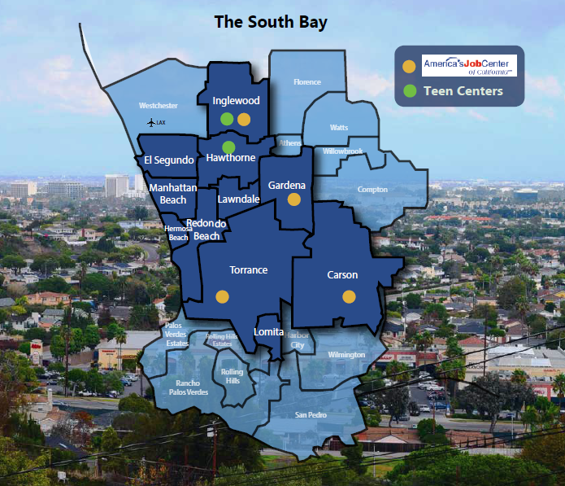
Cities we Service
South Bay Cities:
Hawthorne
Inglewood
Lawndale
El Segundo
Manhattan Beach
Hermosa Beach
Redondo Beach
Gardena
Carson
Torrance
Lomita

Slide 5
Business Support Services
Rapid Response & Layoff Aversion Program
Rapid Response
Layoff Aversion
Strategy to save jobs and help the company regain its ability to grow again and remain competitive.
Services to help minimize or avert
layoffs, i.e. incumbent worker training, customized services, tax relief incentives.
COVID-19 Resources
https://www.sbwib.org/covid-19-resources
One Stop Centers open by appointment
Majority of services are now virtual, including job fairs and training
GROWTH Sectors:
Healthcare, Construction, Advanced Manufacturing, Logistics and Big Box retail

Slide 6
Business & Employment Services

Slide 7
Business Support Services
Recruitment Services
Hiring Support
Job Fairs
New hire and job placement
resources
Publicizing Positions
Targeted Recruitments
Screening/Assessment
Job Matching/Referrals
Work Readiness Support
Skills Testing
Reference Checks
Workforce Training
On-the-Job Training
Customized Training
Apprenticeship Training
Incumbent Worker Training
No cost workshops

Slide 8
Business & Employment Services
Transitional Subsidized Employment Program for Business in
Los Angeles County
Minimum wage entry level employees
SBWIB Provides a wage subsidy during the training period
Employee must work at least 32 hours a week
Expectation to permanently hire

Slide 9
Business & Employment Services
Transitional Subsidized Employment for Non Profit and Govt. Agencies
SBWIB Provides 100% of the salary during the training period

Slide 10
Business & Employment Services
On the Job Training Program
SBWIB Provides up to 75% of the salary for new hires during the first 3 months of training
For jobs in the $11-$20 an hour range

Slide 11
Offered at No Cost to business, non profits and government entities
Interns may work for non-profits or government
entities in any capacity and will be paid by the
SBWIB
Interns are available to private business in the
fields of:
• Manufacturing
• Engineering
• Media Arts industry sectors

Slide 13
FACEBOOK WEBSITE TO SIGN UP
https://careerconnections.fb.com

Slide 14
Business Support Services

Slide 15
Adult Services

Slide 16
Adult Employment Services
Resume preparation help
Job search assistance
Mock Interviews
Career Counseling and workshops
Training
Assessment of skills and abilities
Assistive technologies for people with disabilities
Office equipment to assist in submitting applications
Blueprint for Success – class that teaches career planning
Displaced worker program
Low income adult / Homeless services
Websites: SouthBay1Stop.org
SouthBayJobs.org

Slide 17
Support Services

Slide 18
Who’s Hiring in the South Bay Now
Northrop Grumman - 75
Aerospace Corporation – 50
Geodigm – 4
Ring – 60
Pilot Freight Services – 4
Denny’s – 3
Total Body Experts & Studio Cycle
Car Max - 10
CostCo - 10​
G Medical - 6
CVS - 9
El Super market - 10
24 Hour Home Care - 8
Torrance Memorial Hospital - 60
Home Depot – 55
Hurst Construction
Pelican Products - 15
Starbucks - 10
Target - 15
Ralph's - 10
Whole Foods - 20
Vons – 40
Stamps.com - 17
Starbucks - 20
Walgreens - 5
CRST International - 3
US Xpress – 3
Raytheon
Prime Healthcare
LA Football Stadium
LAX Expansion

Slide 19
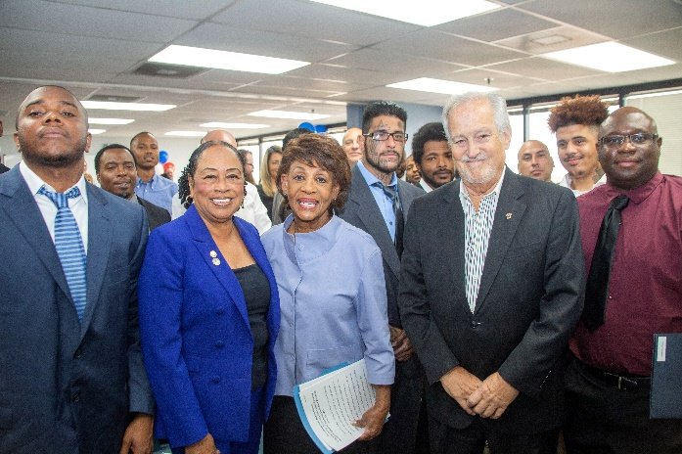
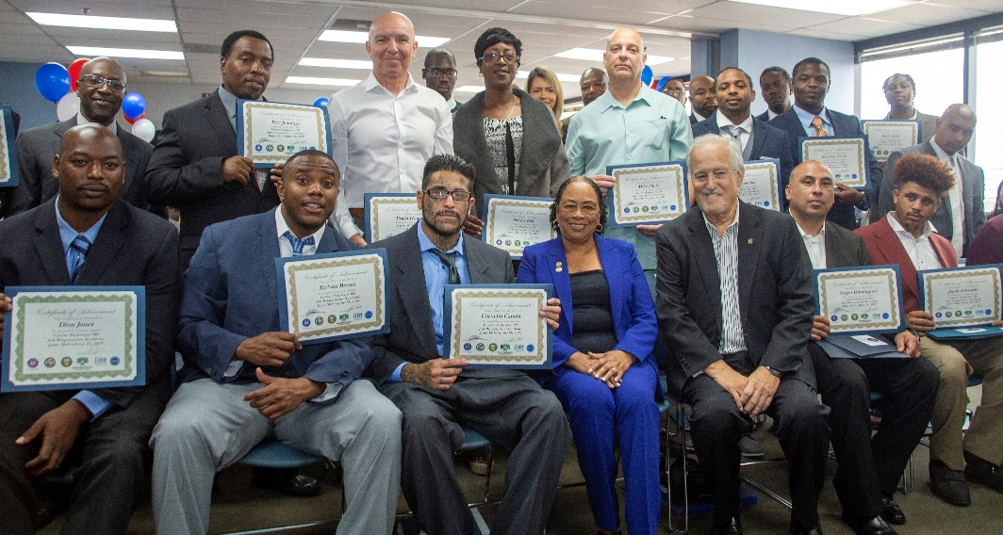
Prison to Employment
Grants
Prison to Employment - Implementation and
Supportive Services Grant
Regional coordination of services
for formerly incarcerated individuals.
SBWIB will manage funds and program
on behalf of the Los Angeles Region
Will serve 750 people
starting September 2019
$8,709,066

Slide 20
Veteran
Services

Slide 21
Youth Services
Programs for Youth
Internship programs
Apprentice programs
On the Job Training
Youth Work Experience Programs
Bridge-to-Work Program for ages 18-21
Job Shadow program
Learn & Earn Program
Pre Apprenticeship in Engineering
South Bay Promise program
Operate Two Teen Centers
Programs for foster kids

Slide 23
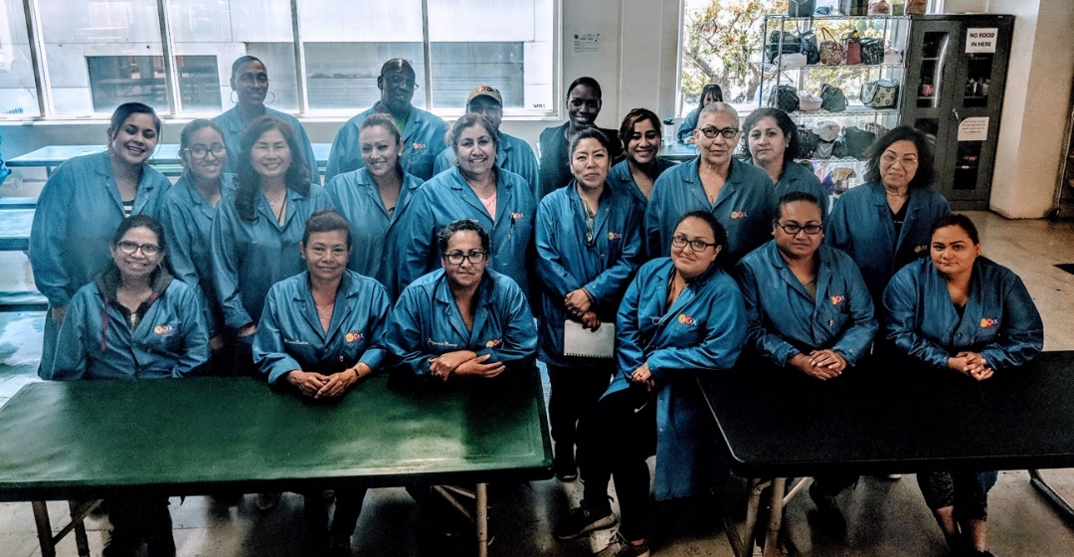
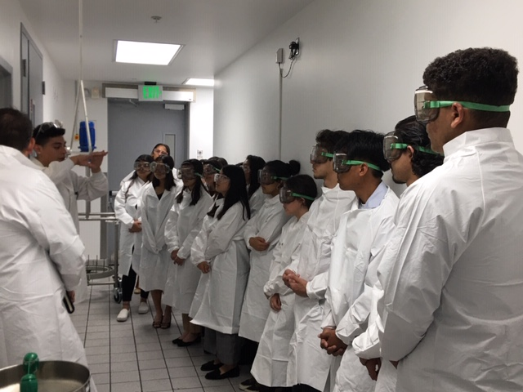
Pre - Apprenticeship
&
Apprenticeship

Slide 24
Aero-Flex Apprenticeship Occupations
Aerospace Engineer
CNC Machine Operator
Industrial Machine System Technician
Industrial Engineering Technician
Aerospace Electronics Technician
Aerospace CNC Machining Technician
www.sbwib.org/aero-flex

Slide 25
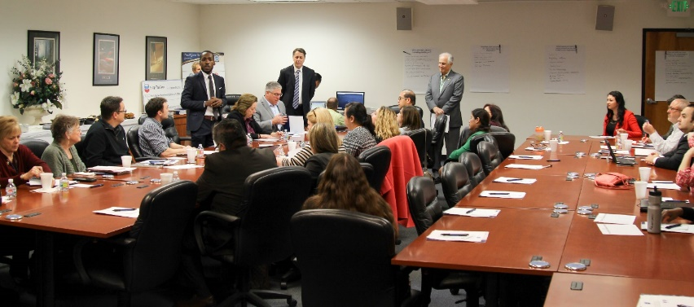
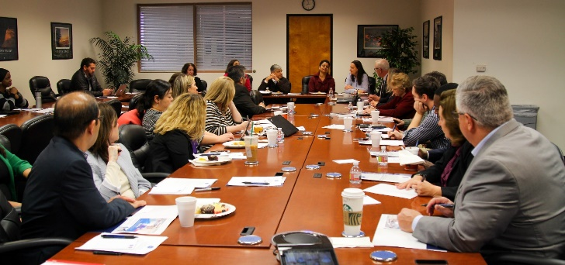
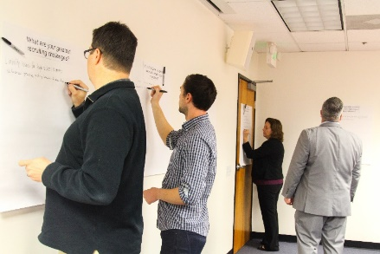
Bio – Flex Apprenticeship Advisory Committee
Other Partners: Freudenberg Medical, Sakura Finetek, EvoRx, Phenomenex

Slide 26
Bio-Flex Apprenticeship
Production / Manufacturing Technician
Maintenance Technician
Quality Control Analysts / Lab Technician
New - Lyophilizer Maintenance Engineer

Slide 27
BioFlex
The Pre Apprenticeship curriculum consists of three learning tracks:
Track I; Work readiness skills training
Track II; Industry specific occupational skills training
Track III; Work Based Learning (OJT)
Student Benefits:
Work readiness certificate
Training certificate
$300-$500 Stipend or Paid work experience
Industry recognized certificate
On-the-job training experience
The SBWIB team is also working with area school districts to develop pre apprenticeship
career exploration opportunities for high school students.
Notes:
Mention that this model can be used with any industry

Slide 28
Blueprint for Workplace Success
Blueprint I
Now Online

Slide 29
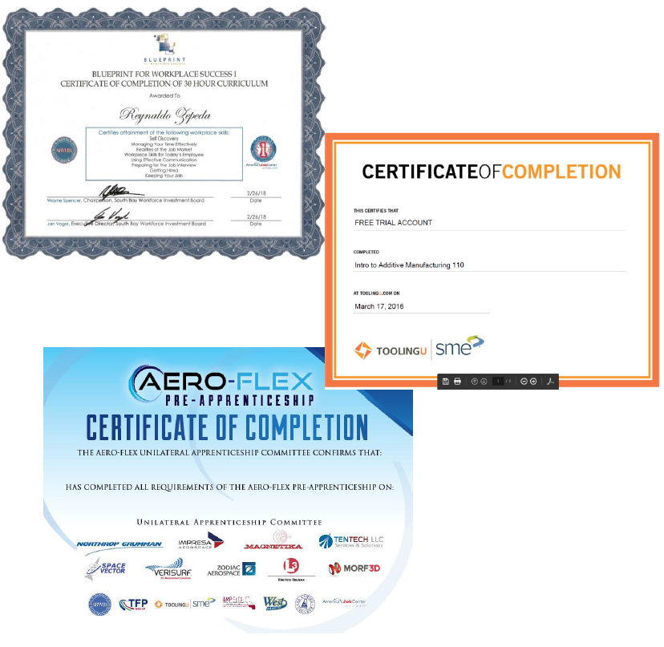

Slide 32
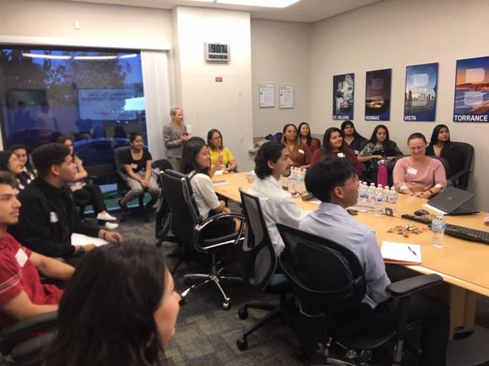
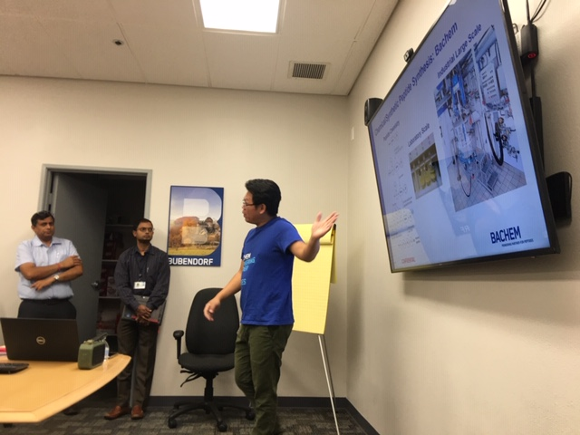
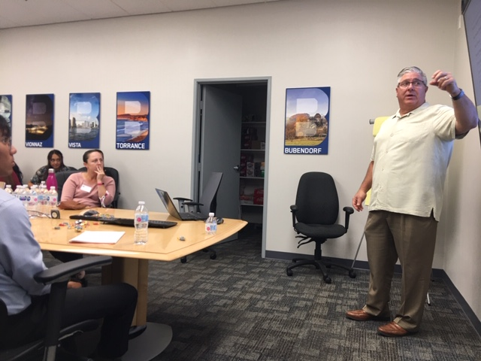

Slide 33
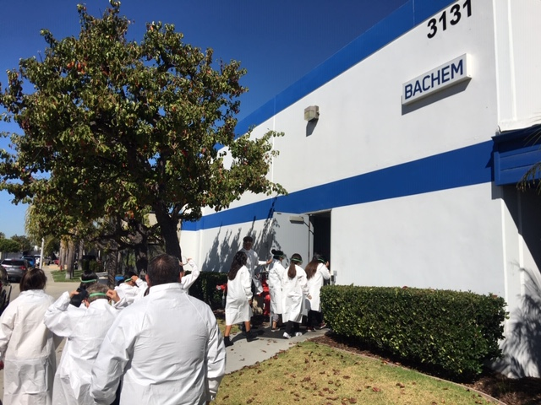
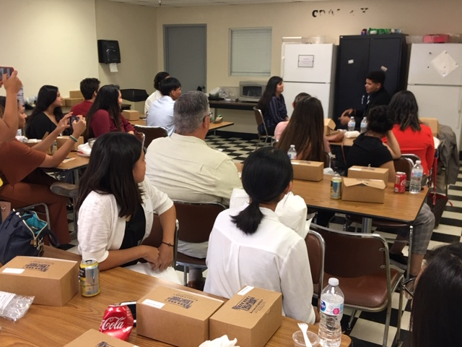

Slide 34
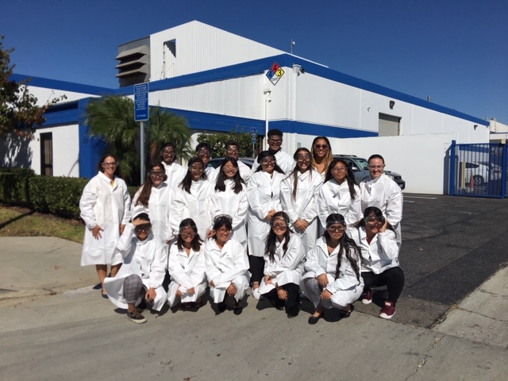

Slide 35
BioFlex
Aero-Flex & Bio-Flex
Virtual
Pre-Apprenticeships

Slide 36
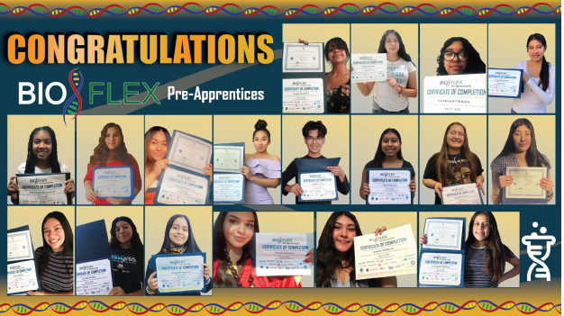
BioFlex
Bio-Flex
Virtual
Pre-Apprenticeships Grads
Now working on developing Youth Apprenticeships Programs

Slide 37
Broadband Project – to develop a high-speed broadband infrastructure network in the South Bay
The South Bay FIBER Network
Partner: South Cities Bay Council of Government
FUNDING RECEIVED:
$1.2 MILLION from Governor
$4.4 Million from Metro
TOTAL $5.6 Million
BROADBAND project

Slide 38
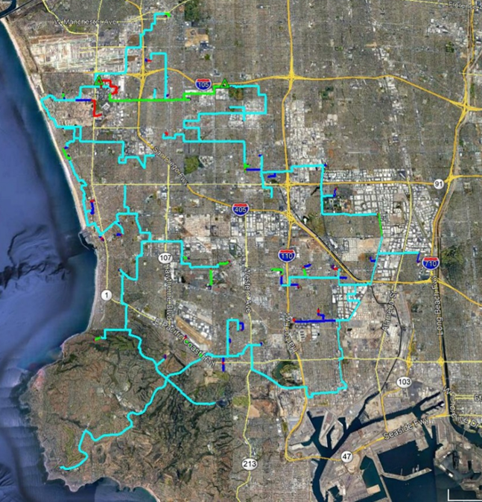
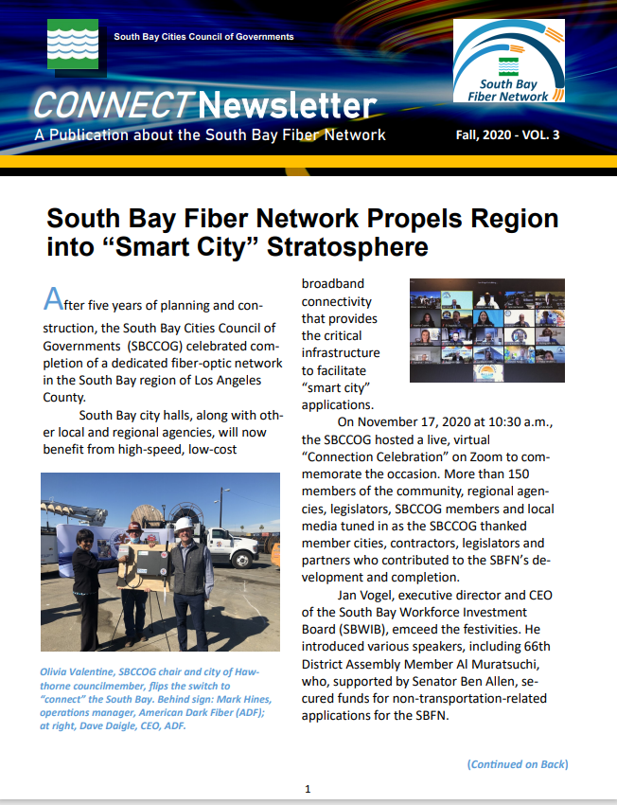

Slide 39
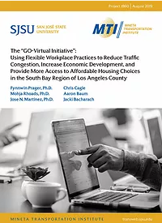
The Impact of Blockchain
on the South Bay Economy
A report prepared by CSUDH South Bay Economics Institute for the South Bay Workforce Investment Board
Telework &
Flexible
Workplace
Practices Study

Slide 40
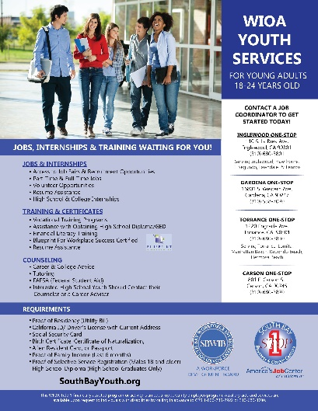
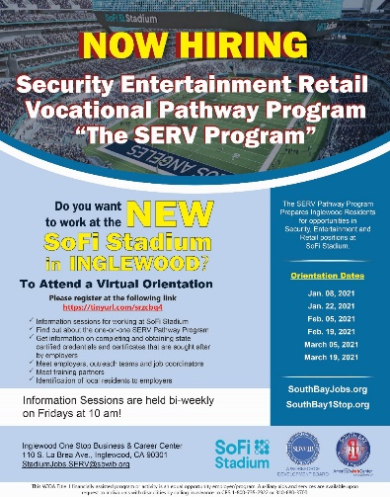
www.southbay1stop.org/flyers

Slide 41
Connect with us
SBWIB.org
SouthBay1Stop.org
SouthBayBusiness.org
SouthBayJobs.org
SouthBayYouth.org

Slide 42
Thank You!
South Bay Workforce Investment Board
11539 Hawthorne Blvd., Suite 500
Hawthorne, CA 90250
310-970-7700
info@sbwib.org
www.sbwib.org
Alisa Stein
Torrance One-Stop
1220 Engracia Ave.
Torrance, CA 90501
310-680-3837
astein@sbwib.org
Don Perry
310-680-3700 ext. 3825
dperry@sbwib.org
Chris Cagle
310-970-7724
ccagle@sbwib.org

